Slide 1
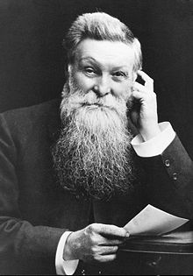
Developing useful new materials
John Boyd
Dunlop

Slide 2
He was born on the 5 February 1840
He was born in Scotland but later moved to Ireland.
He married and had a daughter and son.

Slide 3
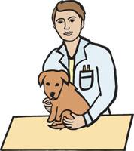
Vet and inventor
He and his
brother James
were both vets.

Slide 4
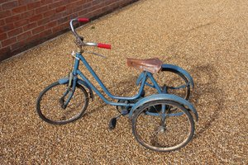
Vet and inventor
He wanted to improve the types on his sons tricycle.
So he invented a new process that improved pneumatic tyres

Slide 5
In October 1887, John Boyd Dunlop developed the first practical pneumatic or inflatable tyre for his son's tricycle .
He used his knowledge and experience with rubber to fit it to a wooden disc.
The tyre was an inflated tube of sheet rubber.

Slide 7
He then took his wheel and a metal wheel from his son's tricycle and rolled both across the yard together.
The metal wheel stopped rolling but the pneumatic continued until it hit a gatepost and rebounded.
Dunlop then put pneumatics on both rear wheels of the tricycle. That too rolled better and Dunlop moved on to larger tyres for a bicycle "with even better results.

Slide 8
Everyone wanted the Dunlop tyres…
A cyclist began to use his tyres because they were so good.
The cyclist began to win many races.

Slide 9
The Dunlop tyre was very successful.

Slide 10
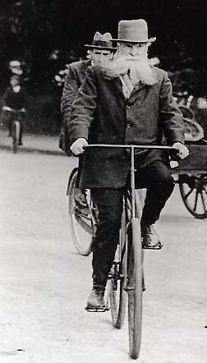
Mr Dunlop was a clever inventor whose ideas created a product that became more and more popular as many people started to drive on smooth tarmac roads.
The company Dunlop is still very successful today.

Slide 12
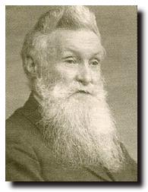
He died in 1921 aged 81.

